Slide 1

Asynchronous Hyperautomata Simulator
Capstone Project Phase A
Raz Kessel
Nevo Gottlieb
Supervisor: Dr. Sarai Sheinvald

Slide 2
Traditional Automata
Mathematical models that process symbol sequences (e.g., words) based on predefined rules.
Commonly used in pattern recognition, formal verification, and language processing.
a
a,b
q0
b
q1
$$a$$
$$b$$
Notes:
"Let's begin with a quick overview of traditional automata. Automata are mathematical models used to process sequences of symbols or words based on predefined rules. These models are widely used in fields such as pattern recognition, formal verification, and language processing.
However, traditional automata come with certain limitations. First, they are designed to handle just one input sequence at a time, which limits their ability to process systems that involve multiple inputs or parallel data streams.
Second, because of this single-input focus, they also struggle to model more complex systems that require interactions between parallel processes, which is often the case in more advanced or real-world scenarios.
These limitations become particularly apparent when we try to extend automata into domains requiring more dynamic input handling, which brings us to the need for more flexible models, such as asynchronous hyperautomata, which I'll discuss later."

Slide 3
Synchronous Hyperautomata
A computational model processing multiple sequences.
All sequences advance together step by step.
Processing multiple input strings simultaneously, transitioning based on a letter from each string
Useful for systems where all components progress at the same time
$$\left({a \atop a}\right)$$
$$\left({\# \atop a}\right)$$
$$\left({\# \atop a}\right)$$
q0
q1
Quantifier: $∀X∃Y$
$$a$$
$$a$$
$$a$$
$$a$$
$$a$$
Notes:
A hyperautomata is an advanced type of automata designed to work with hyperlanguages, which are sets of sets of words.
hyperautomata accept or reject collections of words based on defined relationships between them.
This connection allows hyperautomata to analyz behaviors that depend on the interaction of multiple inputs.
4) In synchronous systems, automata process multiple sequences (or words) in perfect alignment.
5) this model fails to accurately reflect many real-world systems, particularly distributed systems where components experience independent delays or progress at different rates.
In our example, the hyperlanguage operates over two tapes, X and Y.
X holds the first word, and Y holds the second. For any word in the language on one tape, there must be a longer word on the other tape. This means that for every sequence of 'a's in one tape, there's always a longer sequence on the other. Essentially, it represents an infinite language, because the lengths keep growing indefinitely.

Slide 4
Asynchronous Hyperautomata
Definition: A model where sequences progress independently.
Key Idea: Some sequences can advance while others stay in place.
Real-World Use: Reflects systems where components don’t synchronize perfectly.
Research Gap: Lack of comprehensive tools to simulate and analyze these systems.
$$\left({0 \atop \#}\right)$$
$$\left({\# \atop 0}\right)$$
$$\left({0 \atop \#}\right)$$
$$\left({\# \atop 0}\right)$$
$$\left({1 \atop \#}\right)$$
$$\left({\# \atop 1}\right)$$
q0
q1
Quantifier: $∀X∀Y$
$$\left({1 \atop \#}\right)$$
$$\left({\# \atop 1}\right)$$
$$0$$
$$1$$
$$1$$
$$0$$
Notes:
1) Asynchronous hyperautomata are models where sequences progress independently.
2) Allowing some to advance while others remain in place.
3) This reflects real-world scenarios like distributed systems, where different components don't synchronize perfectly. Such models are vital for simulating behaviors in systems like network protocols or concurrent processes, where timing and sequence coordination vary.
In this example, the automaton accepts pairs of binary strings, X and Y, that share the same pairity of 1s. The hyperlanguage ensures that for any pair of strings, the number of 1s matches in a way that their parity (odd or even number of 1s) is preserved. This models a real-world scenario where sequences need to follow specific patterns or rules but progress at different rates."

Slide 5
Proposed Solution
Main Solution: a simulator for analyzing asynchronous hyperautomata.
Key features:
Asynchronous Progression: Simulates independent sequence advancement.
State Visualization: Graphically represents state transitions.
Flexible Input: Allows users to define multiple input words and states during running.
Step-by-Step Simulation: Users can control and observe each transition.
Property Analysis: Provides reports on the behavior of asynchronous systems.
Notes:
"Our solution to the research gap is the development of an asynchronous hyperautomata simulator. This tool will enable researchers to analyze how asynchronous systems behave by simulating the independent progression of multiple sequences. Key features include the ability to visually track state transitions, allowing users to define multiple input words and states by building a modular structure,to observe their asynchronous behavior in a step-by-step simulation. Additionally, the tool will offer detailed reports on system properties.

Slide 6
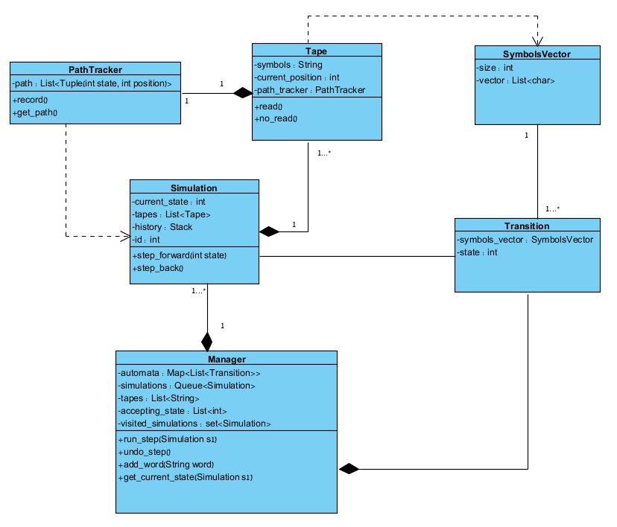
The Structure
Notes:
Lets dive into our core structure which have a several key components working together.
The first one is the manager. This is the object who holds the automata which is represented as a map where the states numbers are the keys and the values for each key(state) are list of Transitions.
Transition is another object that contains a symbol_vector which is a vector of the next symbols to read in each tape, and the state that is resulting from the transition.
Lets go back to the manager, we also have simulations which is the BFS queue of simulations.
Simulation is an object that’s hold the current state of the automata, it holds tapes, which are another object, that holds a string and its position progress.
Simulation also holds a history in the shape of stack.
The last field of the manager I would like to explain is the visited_simulations which is a set of simulations we’ve encountered in order to avoid an already visited simulations.
This is a modular structure that is crucial for the ability to add input words and new states during an already run execution.
לדבר על המודולריות תוך כדי ריצה

Slide 7
The Main Algorithm
Algorithm Hyperautomata Simulation
1: procedure BFS-Simulation(Manager m) 2: Input: m = Manager object containing automata, tapes, and simulations 3: Initialize BFS_queue ← ∅ 4: s₀ ← new Simulation() 5: Initialize visited_set ← s₀ 6: BFS_queue ← BFS_queue ∪ {s₀} 7: while (not all tapes are consumed and current state is not accepting) and BFS_queue ≠ ∅ do 8: s ← BFS_queue.dequeue() 9: if s.current_state is accepting and all tapes are consumed then 10: return s.history 11: end if 12: for each Transition t ∈ m.automata[s.current_state] do 13: if t can progress on current symbols of tapes then 14: s₁ ← s.step_forward(t)
15: end if 15: if s₁ ∉ visited_simulations then 16: visited_simulations ← visited_simulations ∪ {s₁ } 17: BFS_queue ← BFS_queue ∪ {s₁} 18: end if 19: end for 20: end while 21: return Last simulation history
22: end procedure
Notes:
Lets have a quick view on our main algorithm. Which is based on BFS. At first we initializing the first simulation which is in state q0 and the tapes positions are 0.
We are initializing an empty queue and put our first simulation in it.
The main loop runs while not all tapes are consumed and current state is not accepting of the queue is not empty.
So we dequeue the head of the queue simulations, and checks if the current state is accepting and all tapes are consumed,
Okay in this slide we can see the main algorithm of our project, its based on BFS the runs over a simulations.
The added elements we did is to avoid already visited simulations.
The algorithm returns an history of accepting execution or the history of the last simulation which has failed.
Now I will example a run of this algorithm:

Slide 8





















































$$\left({0 \atop \#}\right)$$
$$\left({\# \atop 0}\right)$$
$$\left({0 \atop \#}\right)$$
$$\left({\# \atop 0}\right)$$
1
State:
$$\text{q}\text{₀}$$
$$\left({1 \atop \#}\right)$$
$$\left({\# \atop 1}\right)$$
Tape 1:
$$0$$
$$1$$
q0
q1
Tape 2:
$$1$$
$$0$$
3
$$\left({1 \atop \#}\right)$$
$$\left({\# \atop 1}\right)$$
2
State:
$$\text{q}\text{₁}$$
State:
$$\text{q}\text{₀}$$
Tape 1:
$$0$$
$$1$$
Tape 1:
$$0$$
$$1$$
Tape 2:
$$1$$
$$0$$
Tape 2:
$$1$$
$$0$$
4
State:
$$\text{q}\text{₁}$$
$$\text{q}\text{₁}$$
State:
$$\text{q}\text{₁}$$
State:
$$\text{q}\text{₁}$$
State:
Tape 1:
$$0$$
$$1$$
$$0$$
$$1$$
Tape 1:
$$0$$
$$1$$
$$0$$
$$1$$
Tape 1:
Tape 1:
Tape 2:
$$1$$
$$0$$
$$0$$
Tape 2:
$$1$$
$$0$$
$$0$$
Tape 2:
$$1$$
Tape 2:
$$1$$
6
5
7
State:
$$\text{q}\text{₀}$$
Tape 1:
$$0$$
$$1$$
Tape 2:
$$1$$
$$0$$
1
2
3
4
5
6
7
8
State:
$$\text{q}\text{₀}$$
Tape 1:
$$0$$
$$1$$
Tape 2:
$$1$$
$$0$$
8

Slide 9
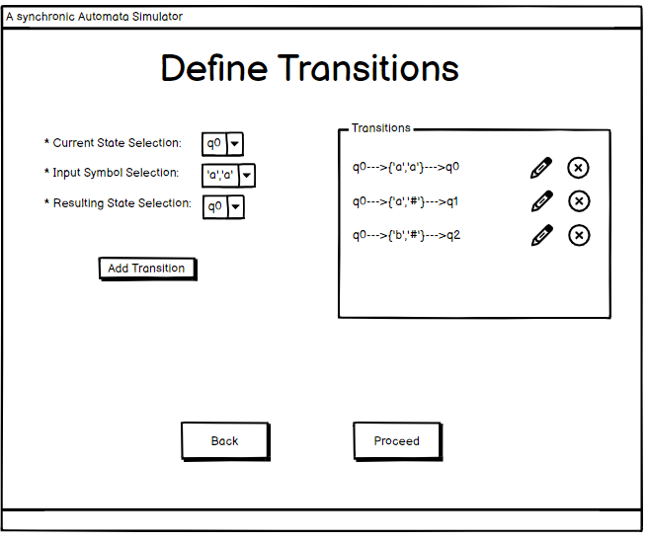
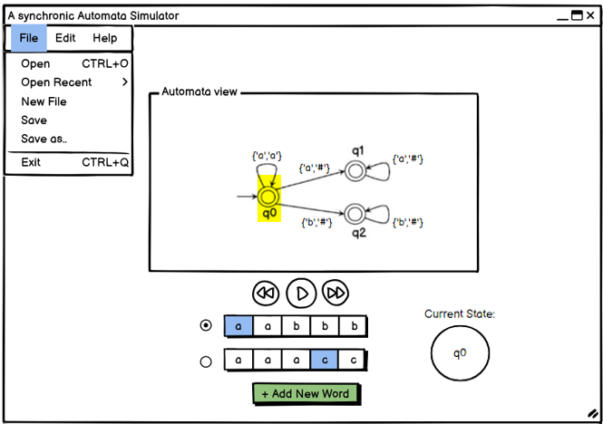
GUI and User Interface

Slide 10
Testing & Challenges
Testing Strategy:
Unit tests: Verify automata components.
Functional tests: Simulate asynchronous hyperautomata.
Performance tests: Measure efficiency with large inputs.
Expected Results:
Accurate state identification and smooth asynchronous simulation.
Efficient handling of large automata.
Challenges:
Managing state space growth.
Ensuring correctness in complex automata.
Adding inputs during executions.
Creating clear visualizations for transitions.
Notes:
“Our testing strategy will include three key components. First, we'll conduct unit tests to verify the automata's core elements, such as the definitions and state management. Next, we'll perform functional tests, where we simulate asynchronous hyperautomata, including more complex scenarios. Finally, we'll run performance tests to assess how well the system handles larger automata and extensive inputs.
We expect to achieve accurate state identification and smooth asynchronous transitions. We’re also aiming for efficient handling of large automata, which could provide insights into distributed systems.
However, we anticipate some challenges. One major hurdle will be managing the exponential growth in the state space. Another challenge will be ensuring the correctness of complex automata.
In addition, the adding of new input words may be very challenging.
Lastly, developing clear visualizations for complex transitions will be crucial for debugging and understanding the system’s behavior."

Slide 11
Conclusion
The asynchronous hyperautomata simulator will bridge a gap in understanding complex distributed systems and parallel processes.
Expected Achievements:
Simulate asynchronous behaviors.
Integrate real-time visualization for analysis.
Future Directions:
Expand hyperlanguage support.
Optimize for complex systems.
Apply in fields like networking and multi-agent coordination.
Notes:
"As we conclude this phase of the project, we have outlined some key goals and future directions.
First, we expect the simulator to successfully handle asynchronous behaviors, giving us deeper insights into how hyperautomata operate. Additionally, real-time visualization will allow us to analyze the automata’s behavior as it evolves.
Looking ahead, there are several directions we can take. We plan to expand the simulator’s support for more advanced hyperlanguages and optimize its performance to handle more complex systems. Beyond that, there’s exciting potential to apply this tool to fields like network protocols and multi-agent coordination.
In summary, this project is poised to contribute significantly to our understanding of distributed systems, and I’m excited about where we can take it next."

Slide 12
Thank you for listening!
Notes:
מספור שקפים

